Slide 1

Equinox Project 3.6 Release Review
Equinox Project Leadership

Slide 2
Highlights
3.6 new features:
  Introduction of p2 API
  Multiple instances of p2 in one VM
  New Discovery UI
  Multi-locale support in extension registry
  Added support to send arguments to a running instance of Eclipse
API quality:
  High. No breaking changes to Equinox API
  Binary compatible for compliant plug-ins
  24 new p2 API/SPI packages
  In addition to the new p2 API 26 other classes or interfaces have new API (either new types, or existing types with new members)
IP Clearance and Licenses:
  All licenses and about files are in place as per the Eclipse Development Process, the Due Diligence Process was followed for all contributions
Community and Committer Diversity:
  41 committers, 21 active in past 9 months
  Organizations: IBM, EclipseSource, Cloudsmith, Individuals, Prosyst, Sonatype, compeople AG, WeigleWilczek GmbH, Tasktop
  Geographies: Canada (9), USA (6), Germany (3), Bulgaria (1), Sweden (1), France (1)
  Commits: IBM (52.0%), Sonatype (27.0%), Cloudsmith (10.1%), EclipseSource (5.9%), Individuals (1.9%), Prosyst (1.4%), Tasktop (1.2%)
  Consumed by all other Eclipse projects
Notes:
Committer info:
http://dash.eclipse.org/dash/commits/web-app/commit-count-loc.php?top=eclipse&range=1yr

Slide 3
Themes and Plan Items
Scalability
  Support added for low memory events
  Improve p2 resolver and engine performance
Robustness
  Define p2 API and JavaDoc
  Multi-locale support in the extension registry
  Provide p2 repository verification tools
Consumability
  API completeness
  New p2 UI workflows
  Improve p2 error reporting
  Improve p2 responsiveness
  Integration of servlet bridge with p2
  Define p2 API
The Future
  OSGi standards participation
  Investigate improvements to the extension registry
http://www.eclipse.org/projects/project-plan.php?projectid=eclipse

Slide 4
Deferred 3.6 Plan Items
p2 install flexibility
Use p2 to manage and run on other OSGi framework implementations

Slide 5
New and Noteworthy
New Equinox Weaving feature included in Helios
Support for multi-session Equinox console
Added Event Admin implementation to RCP
Revert support added to p2 director
Multi-locale support in extension registry
Added Servlet filter support
Performance improvements in p2
Improvements in proxy handling
Defined event topic for memory events
New server side features for products to use

Slide 6
3.6 Plug-in Changes from 3.5
Added Plug-ins (10)
org.eclipse.equinox.p2.discovery.compatibility
org.eclipse.equinox.p2.discovery
org.eclipse.equinox.p2.operations
org.eclipse.equinox.p2.ql
org.eclipse.equinox.p2.ui.discovery
org.eclipse.equinox.servletbridge.extensionbundle
org.eclipse.equinox.weaving.aspectj
org.eclipse.equinox.weaving.caching
org.eclipse.equinox.weaving.caching.j9
org.eclipse.equinox.weaving.hook
Removed Plug-ins (2)
org.eclipse.equinox.p2.exemplarysetup
org.eclipse.equinox.p2.tools

Slide 7
Non-Code Aspects
The 3.6 release will contain updated User and ISV documentation
Community is very active
  Mailing lists and newsgroups have steady activity
    Equinox-dev@eclipse.org, p2-dev@eclipse.org
  Blogs dedicated to Eclipse are active e.g.
    http://www.planeteclipse.org
  Wiki content is growing
    http://wiki.eclipse.org/Equinox
    http://wiki.eclipse.org/Equinox/p2

Slide 8
Non-Code Aspects
Internationalization
  Latin1 and Latin2 locales are supported in all operating environments
  DBCS locales are supported on all platforms
  GB18030-1 Chinese codepage standard is supported on Windows, Linux GTK and Mac.
Localization
  Tested for Localization and participating in Babel Project
Accessibility
  Tested for accessibility, but Equinox has minimal GUI code

Slide 9
Non-Code Aspects
Articles, examples, and tutorials
  Numerous Webinars and Podcasts
  Library of demo code in Equinox incubator
  Tutorials given at EclipseCon and other conferences
  New project named Toast in the Examples project demonstrating the various runtime technologies at Eclipse.

Slide 10
Platform Quality API
API quality is a collaborative effort that involves the experience of the developers working on the Equinox project, and feedback from consumers.
API changes and proposed API additions are often broadcast to mailing lists to raise awareness of the changes and encourage discussion and feedback.
API changes between 3.5 and 3.6 are checked automatically by API tooling integrated into integration build process.
No breaking API changes in 3.6
The PMC is comfortable supporting the API that is in the Equinox project 3.6

Slide 11
3.6 API – Equinox
New p2 API/SPI packages
org.eclipse.equinox.frameworkadmin
org.eclipse.equinox.p2.core
org.eclipse.equinox.p2.core.spi
org.eclipse.equinox.p2.engine
org.eclipse.equinox.p2.engine.query
org.eclipse.equinox.p2.engine.spi
org.eclipse.equinox.p2.metadata
org.eclipse.equinox.p2.metadata.expression
org.eclipse.equinox.p2.metadata.index
org.eclipse.equinox.p2.operations
org.eclipse.equinox.p2.planner
org.eclipse.equinox.p2.ql
org.eclipse.equinox.p2.query
org.eclipse.equinox.p2.repository
org.eclipse.equinox.p2.repository.artifact
org.eclipse.equinox.p2.repository.artifact.spi
org.eclipse.equinox.p2.repository.metadata
org.eclipse.equinox.p2.repository.metadata.spi
org.eclipse.equinox.p2.repository.spi
org.eclipse.equinox.p2.repository.tools.analyzer
org.eclipse.equinox.p2.repository.tools.comparator
org.eclipse.equinox.p2.touchpoint.eclipse.query
org.eclipse.equinox.p2.ui
org.eclipse.equinox.simpleconfigurator.manipulator

Slide 12
3.6 API – Equinox
New
Support to allow multiple OSGi console sessions
Support to get a bundle data area from a Location service
Support to dynamically enable and set debug tracing
Launcher options to pass parameters to a running Eclipse instance
Platform constants for ppc 64
LocaleProvider service interface to support multi-locale scenarios
Support for asynchronous application results
Defined event topic constant for memory events
Support programatic access to declarative services runtime
Support for servlet filters
Support to determine when preferences have been overridden
Support for wildcards to match preference keys to transfer
Support for multi-locale extension registry

Slide 13
Tool Usability
As part of the Runtime project, tooling falls outside the Equinox project mandate
Some developer tools such as console, command line tools provided
Work closely with the PDE project which provides tooling for Equinox

Slide 14
Architectural Issues
Primary runtime is still a 1.4 JRE. Complementary functionalities on Java SE 5 (junit4, APT 5) and Java SE 6 (APT 6, compiler API)
Many core Equinox bundles use the OSGi minimum 1.2 profile
p2 uses Java SE 5 syntax (generics etc.) but is down compiled to support J2SE 1.4 and the OSGi minimum 1.2 profile
10 new bundles, 2 removed bundles

Slide 15
End of Life Issues
When evolving API the Equinox Project will, whenever possible, deprecate the affected API methods and continue to keep them operational.
Exceptions to this rule are in the 3.6 migration guide.

Slide 16
Bugzilla
Between June 25, 2009 and May 21, 2010 (RC2)
  More than 1500 reports were created
  Over 1500 were resolved
  Over 500 were resolved without changing code
    invalid, duplicate, worksforme, etc...
  Over 70 were backported to 3.5.x maintenance
Current state (RC3) is
  3 blockers, 18 critical
  0 P1, 8 P2

Slide 17
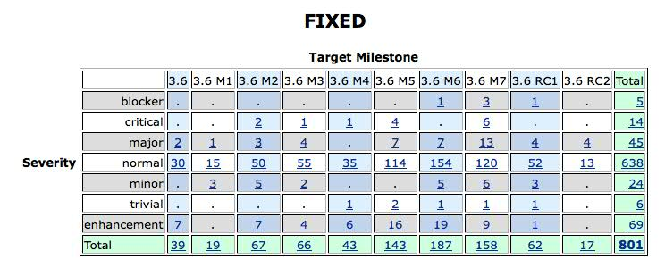
Bug resolution during 3.5

Slide 18
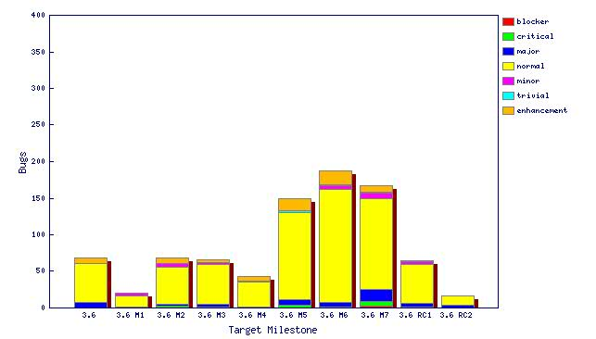
Resolved bugs including fixed, invalid, …

Slide 19
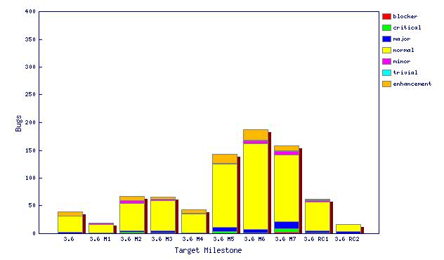
Fixed bugs (only)

Slide 20
Standards
OSGi
  Service Platform Core Specification, Release 4.2
  Elements of the OSGi Service Platform Service Compendium, Release 4.2
  Continued development of the next OSGi Specification (tentatively called Release 4.3) is going on in a branch.

Slide 21
UI Usability
Strings are externalized to support translation into other languages.
Extensive use of mnemonics and shortcut keys in the user interface enhances usability.
Full Bidirectional support (mirroring) on Windows and Linux GTK, bidirectional text on Mac OS X
Accessibility support for Windows, Linux GTK and Mac OS X
We are not aware of any non-compliance with accessibility standards in the user interface

Slide 22
Schedule
Milestones every 6 weeks, 6 cycle duration
  API frozen on March 12 (M6), Feature freeze April 30 (M7)
  http://www.eclipse.org/projects/project-plan.php?projectid=rt.equinox#release_milestones
Tracked schedule
  All milestones delivered as promised
End game (release candidate) milestones for 4 cycles
  Duration reduced from 2-week to 1-week cycles at RC2 milestone
  No new features or API allowed without proper approvals
  Development to end on June 3, 2010
  Increasingly stringent approval, checking, and change notification requirements in this stage
  http://www.eclipse.org/eclipse/development/plans/freeze_plan_3.6.php

Slide 23
Process
The Equinox project is developed using an open, transparent, and inclusive process
Teams rely on Bugzilla, mailing lists and newsgroups for input
Weekly planning calls conducted with the PMC and component leads
  Meeting minutes posted on the Equinox wiki page
Component teams have publicly available milestone plans on the wiki

Slide 24
Community
Equinox team members are active in Bugzilla, newsgroups, and mailing lists
Blogs started by Equinox committers are active
  http://www.planeteclipse.org
Some teams are using the equinox-dev IRC channel
  irc://irc.freenode.net/#equinox-dev
  also see: http://wiki.eclipse.org/index.php/IRC
The Equinox team participates in code camps, conference presentations, and tutorials, including
  EclipseCon, JavaOne, JavaWorld, JAOO, Eclipse Summit Europe, Eclipse Forum Europe, JAX, JAX Asia
The Equinox team interacts with other open source projects, standards bodies, and other projects on eclipse.org, including
  OSGi, Apache, JCP

Slide 25
IP Issues
All significant and third party contributions have been reviewed and approved by Eclipse legal.
About files and license files are complete and correct.
Draft IP log:
  http://www.eclipse.org/projects/ip_log.php?projectid=rt.equinox

Slide 26
Project Plan for Equinox 3.7
Still in planning stage

